Slide 1
Insertion, Merge & Quick Sort
Faisal Bin Ashraf

Slide 2
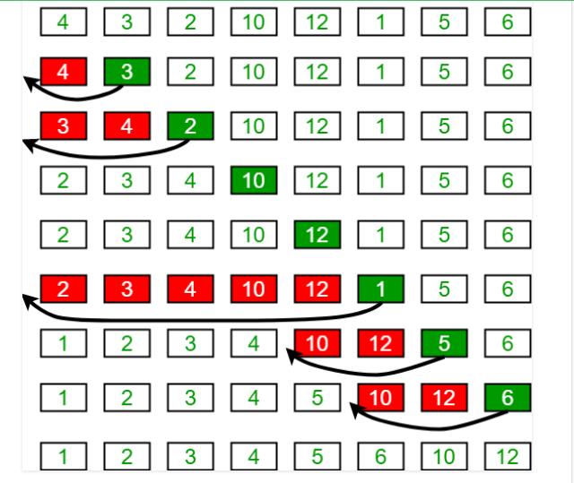
INSERTION SORT

Slide 3
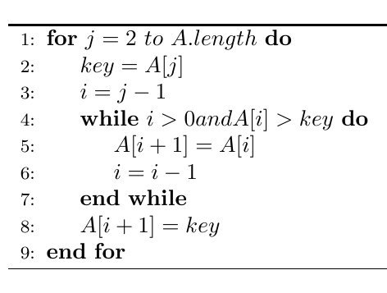
Insertion Sort Pseudo Code:

Slide 4
MERGE SORT
DIVIDE:
7 | 2 | 1 | 6 | 8 | 5 | 3 | 4
7 | 2 | 1 | 6 |  | 8 | 5 | 3 | 4
7 | 2 |  | 1 | 6 |  | 8 | 5 |  | 3 | 4
7 |  | 2 |  | 1 |  | 6 |  | 8 |  | 5 |  | 3 |  | 4

Slide 5
CONQUER:
7 |  | 2 |  | 1 |  | 6 |  | 8 |  | 5 |  | 3 |  | 4
2 | 7 |  | 1 | 6 |  | 5 | 8 |  | 3 | 4
1 | 2 | 6 | 7 |  | 3 | 4 | 5 | 8
1 | 2 | 3 | 4 | 5 | 6 | 7 | 8

Slide 6
Merge (L, R, A):
nL = length of L
nR = length of R
i, j, k = 0
while i < nL & j < nR:
if L[i] <= R[i]:
A[k] = L[i]
i++
else :
A[k] = R[j]
j++
k++
while i < nL :
A[k] = L[i]
i++
k++
while j < nR :
A[k] = R[j]
j++
k++
MergeSort (A):
n = length of A
if n<2:
return
mid = n/2
left = A[0 to mid-1]
right = A[mid to n-1]
MergeSort(left)
MergeSort(right)
Merge(left, right, A)

Slide 7
QUICK SORT
Pivot
7 | 2 | 1 | 6 | 8 | 5 | 3 | 4
[0]
[1]
[2]
[3]
[4]
[5]
[6]
[7]
PARTITION
<= Pivot
Pivot
> Pivot
2 | 1 | 3 | 4 | 8 | 5 | 7 | 6
[0]
[1]
[2]
[3]
[4]
[5]
[6]
[7]

Slide 8
2 | 1 | 3 | 4 | 8 | 5 | 7 | 6
[0]
[1]
[2]
[3]
[4]
[5]
[6]
[7]
2 | 1 | 3 |  | 8 | 5 | 7 | 6
[0]
[1]
[2]
[4]
[5]
[6]
[7]
1 | 2 |  |  | 8 | 5 | 7 | 6
[0]
[1]
[4]
[5]
[6]
[7]
 | 2 |  |  | 8 | 5 | 7 | 6
[1]
[4]
[5]
[6]
[7]

Slide 9
Pseudocode of QuickSort
QuickSort(A, start, end)
{
if start<end :
pivotIndex = Partition(A, start, end)
QuickSort(A, start, pivotIndex-1)
QuickSort(A, pivotIndex+1, end)
}
Partition(A, start, end)
{
pivot = A[end]
pIndex = start
for i= start to end-1 :
if A[i] < pivot :
swap A[i], A[pIndex]
pIndex = pIndex +1
}

Slide 10
Merge Sort Vs Quick Sort
Merge Sort | Quick Sort
O(nlgn) Worst case running time O(n) Space Complexity (Not in-place) | O(nlgn) Average case running time O(n^2) Worst case running time ( in-place)

